Slide 1
SMART ONLINE PARKING AND RESERVATION SYSTEM

Slide 2
INDEX
Abstract
Objective of project
Problem Statement
Scope And Motivation
Introduction
Literature survey
Existing Method
Disadvantages
Proposed method
Advantages
Project Flow
Hardware and Software Requirements
Architecture
Modules
UML Diagram
Output Screens
Future Enhancement
Conclusion
References

Slide 3
ABSTRACT
The SMART ONLINE PARKING AND RESERVATION SYSTEM is an innovative web application designed to optimize parking management for both users and lenders. Utilizing a user-friendly interface, the system allows users to view maps, search for available parking spaces, and book them seamlessly. Users must log in to create an account, add their vehicle details, and reserve a parking spot. Additionally, the application provides functionalities for users to update their status upon leaving the parking area and give feedback through ratings, enhancing user experience and accountability.
On the lender side, the system enables individuals with vacant parking spaces to sign up, add their locations, and manage bookings effectively. Lenders can view all parking reservations and ratings received, fostering a transparent and trustworthy environment. Developed with a robust backend in Spring Boot and a dynamic frontend in React, paired with a MySQL database, this system aims to alleviate parking woes, improve accessibility, and encourage efficient use of available resources, thus contributing to smarter urban mobility solutions.
Keywords: parking, vehicles, places.

Slide 4
OBJECTIVE OF PROJECT
The objective of the SMART ONLINE PARKING AND RESERVATION SYSTEM is to streamline the parking management process by providing an efficient platform for users and lenders. The system aims to facilitate real-time parking space availability, enabling users to search, book, and rate parking spots conveniently. For lenders, it offers an opportunity to monetize unused parking areas by managing bookings effectively. Ultimately, the project seeks to enhance urban mobility, reduce congestion, and improve overall parking experience for all stakeholders.

Slide 5
PROBLEM STATEMENT
The SMART ONLINE PARKING AND RESERVATION SYSTEM addresses the growing challenge of parking shortages and inefficiencies in urban areas. As cities become increasingly congested, finding available parking spaces becomes a time-consuming and frustrating task for drivers. Traditional parking management methods often lead to underutilization of available parking spots, resulting in increased traffic congestion and pollution. Additionally, property owners with vacant parking spaces lack a streamlined mechanism to offer their spaces for public use. This project aims to resolve these issues by creating a digital platform that connects users in need of parking with lenders who have available spaces, thereby optimizing parking resource management and enhancing the overall urban mobility experience.

Slide 6
SCOPE:
The scope of the SMART ONLINE PARKING AND RESERVATION SYSTEM encompasses a comprehensive solution for both users and lenders in the parking ecosystem. For users, it includes features such as real-time parking space search, booking management, vehicle registration, and rating submissions. Lenders can manage their available spaces, view bookings, and receive feedback from users. The system aims to integrate mapping services for easy navigation and will be developed using Spring Boot, React, and MySQL, ensuring scalability and reliability in urban environments.
MOTIVATION:
The motivation behind the SMART ONLINE PARKING AND RESERVATION SYSTEM stems from the pressing need to address urban parking challenges exacerbated by increasing vehicle ownership and limited space. With the rising congestion in cities, the project aims to provide a solution that enhances convenience for users while promoting the efficient utilization of available parking resources. By bridging the gap between drivers and property owners, the system seeks to foster a sustainable and user-friendly parking ecosystem, ultimately contributing to improved urban mobility and reduced traffic congestion.

Slide 7
INTRODUCTION
The SMART ONLINE PARKING AND RESERVATION SYSTEM is a cutting-edge solution designed to tackle the prevalent issues of parking scarcity and inefficiency in urban environments. By leveraging modern web technologies, this platform connects users seeking parking with lenders who have available spaces. The system facilitates seamless searching, booking, and managing of parking spots, enhancing convenience for users while allowing property owners to optimize their unused spaces. Ultimately, this project aims to revolutionize urban parking dynamics and promote smarter, more sustainable city living.

Slide 8
LITERATURE SURVEY
Year | Author(s) | Title | Outcomes
2023 | Zhang et al. | "Intelligent Parking Management System Using IoT and Machine Learning" | This study presents an IoT-based parking management system that utilizes machine learning algorithms for real-time parking space detection and prediction. The outcomes demonstrated a significant reduction in parking search time and increased user satisfaction. The system was found to effectively manage parking resources and reduce congestion in urban areas. By integrating data analytics, the proposed solution showed potential for scalability and adaptability to various urban environments.
2022 | Patel and Singh | "Smart Parking Systems: A Review of Current Trends and Future Directions" | This review article discusses the evolution of smart parking systems, focusing on technologies such as IoT, mobile applications, and data analytics. The authors highlighted the effectiveness of real-time data in enhancing user experience and optimizing space utilization. Key outcomes include identifying challenges in system integration and suggesting future research directions to improve the accuracy and reliability of parking solutions. The review emphasizes the need for user-centric designs to increase adoption rates.
2021 | Lee et al. | "A Survey on Smart Parking Systems: From Sensor Networks to Intelligent Management" | The authors conducted a comprehensive survey on smart parking systems, detailing the role of sensor networks and data processing in enhancing parking management. Key outcomes indicate that implementing these technologies can significantly improve parking space availability and reduce traffic congestion. The survey also identified gaps in existing research, such as the need for more robust user engagement mechanisms and the integration of sustainable practices in parking solutions.
2023 | Kumar et al. | "Leveraging Machine Learning for Smart Parking Solutions: A Comprehensive Study" | This study explored the application of machine learning techniques in smart parking systems. Outcomes revealed that machine learning models could accurately predict parking space availability based on historical data, significantly enhancing user convenience. The study emphasized the importance of integrating real-time data from various sources to create a comprehensive parking solution, leading to better resource allocation and improved urban mobility. The findings highlight the potential for machine learning to transform traditional parking management.
2022 | Wong and Chen | "A Review of Mobile Applications for Smart Parking Management" | This review analyzed mobile applications designed for smart parking management. The outcomes showed that these applications effectively improve user engagement and satisfaction by providing real-time information on parking availability and reservations. The study found that features like user ratings and feedback mechanisms enhance accountability and trust in the system. Additionally, the authors emphasized the need for better integration between mobile applications and backend systems to streamline operations and improve user experience.

Slide 9
EXISTING SYSTEM
The existing parking management systems are often fragmented and inefficient, relying heavily on traditional methods such as signage and manual enforcement. Many cities lack real-time data on parking availability, leading to unnecessary searching and increased congestion. Furthermore, these systems do not provide a centralized platform for users to reserve spaces in advance or for property owners to list their available parking areas. This results in underutilization of parking resources and a frustrating experience for both drivers and property owners, highlighting the need for a more integrated solution.
DISADVANTAGES
Lack of real-time availability updates, leading to inefficient use of parking spaces.
Ineffective management of parking resources, resulting in increased congestion and frustration for users.
Limited accessibility for property owners to monetize unused parking areas effectively.

Slide 10
PROPOSED METHOD
The proposed method for the SMART ONLINE PARKING AND RESERVATION SYSTEM involves developing a web application that integrates user-friendly features for seamless interaction between users and lenders. Utilizing Spring Boot for the backend and React for the frontend, the system will enable users to view maps, search for parking spaces, and make reservations in real time. Lenders will be able to list available parking areas and manage bookings. Additionally, the application will incorporate user feedback mechanisms to enhance service quality and user satisfaction.

Slide 11
ADVANTAGES
Real-time Availability: Users can view and book available parking spaces instantly, reducing time spent searching for parking.
Enhanced User Experience: The platform offers a seamless booking process, enabling users to manage reservations and provide feedback easily.
Monetization for Property Owners: Lenders can generate income by listing their unused parking spaces, maximizing resource utilization.

Slide 12
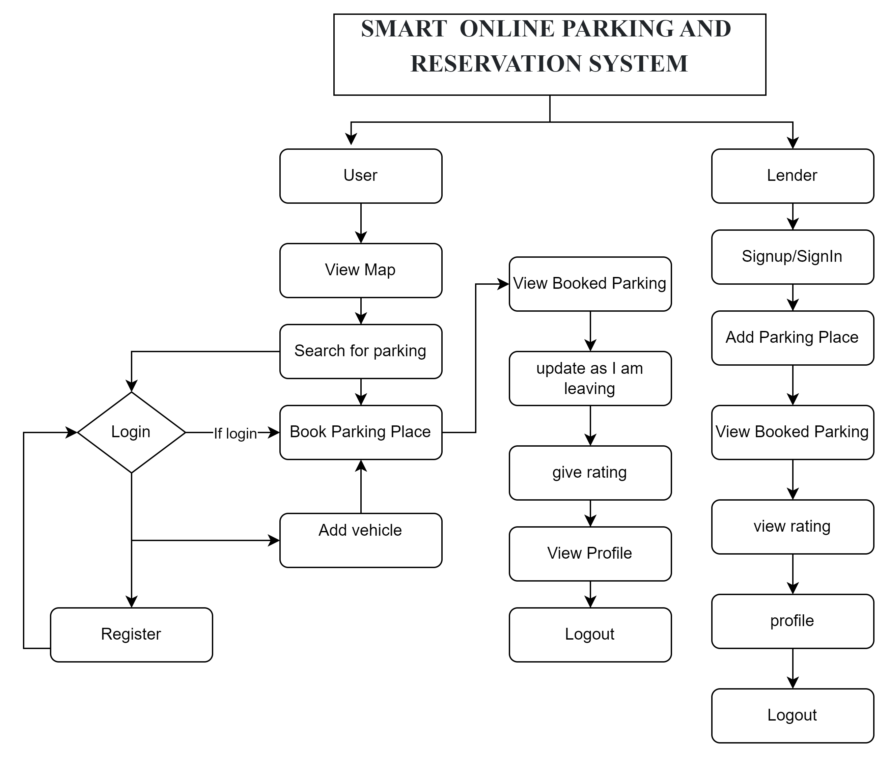
WORK FLOW

Slide 13
HARDWARE & SOFTWARE REQUIREMENTS
SOFTWARE REQUIREMENTS:
Operating System : Windows95/98/2000/XP
Application Server : Tomcat 7.0
Front End : React JS
Scripts : JavaScript.
Backend Language : SpringBoot
Database : MySQL 6.0
IDE : Visual Studio Code
HARDWARE REQUIREMENTS:
Processor : Intel i3
RAM : 4GB
Hard Disk : 500 GB

Slide 14
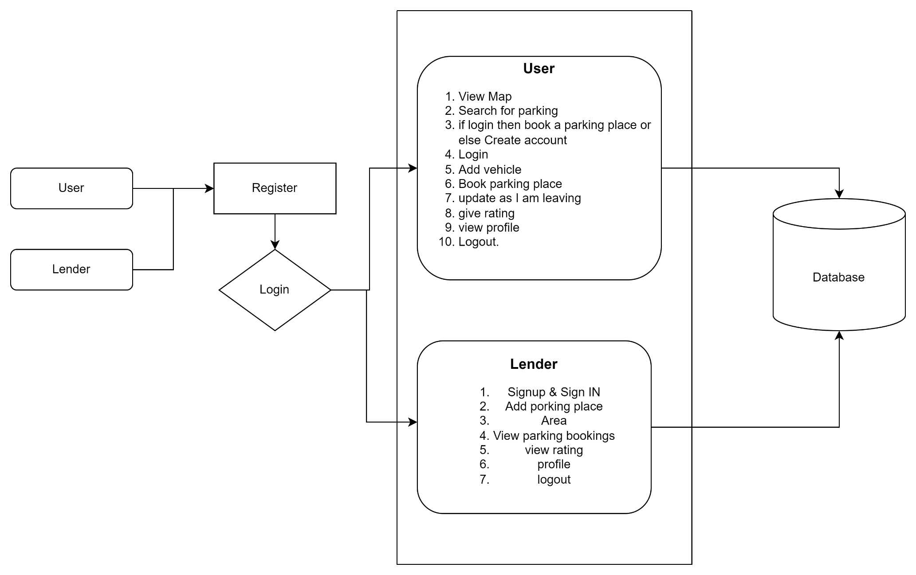
Architecture

Slide 15
MODULES
1.User
View Map: In the Landing page user will view the map there will be lot of parking places
Search for parking: User will search for the parking place where he want to park his vehicle
If login then book a parking place or else Create account: without login user can not book the parking place
Register: User need to create account for the first time
Login: User need to login with valid credentials which are created at the time of registration
Add vehicle: User need to add the vehicle information which he wants to park
Book parking place: After selecting the place user books the parking place for the vehicle
Update as I am leaving: When user is leaving the place he can update an as he is leaving
Give rating: User is able to give rating about the place
View profile: User can see the personal details here
Logout: After all operations user doing logout from the portal and can leave the portal

Slide 16
MODULES
Lender
Signup & SignIn: Here lender or property owner creates the account and login to the portal.
Add parking place: Lender Add the parking place with area details,
View parking bookings: Here Lender views all bookings done by the user for the particular place.
view rating: User given ratings lender can see.
Profile: Lender can see the personal details he entered during signup.
Logout: After performing all operations Lender can leave the portal by doing Logout.

Slide 17
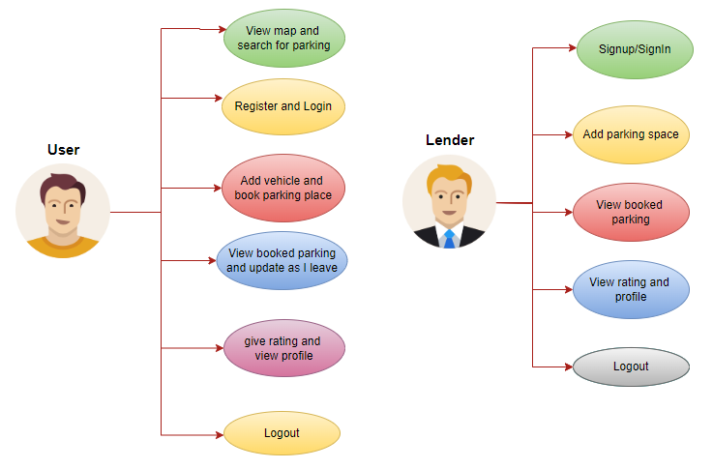
UML Diagrams
Use Case Diagram:
A use case diagram in the Unified Modeling Language (UML) is a type of behavioral diagram defined by and created from a Use-case analysis. Its purpose is to present a graphical overview of the functionality provided by a system in terms of actors, their goals (represented as use cases), and any dependencies between those use cases. The main purpose of a use case diagram is to show what system functions are performed for which actor. Roles of the actors in the system can be depicted.

Slide 18
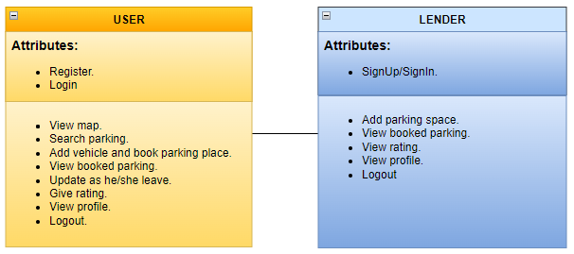
UML Diagrams
Class Diagram:
In software engineering, a class diagram in the Unified Modelling Language (UML) is a type of static structure diagram that describes the structure of a system by showing the system's classes, their attributes, operations (or methods), and the relationships among the classes. It explains which class contains information.

Slide 19
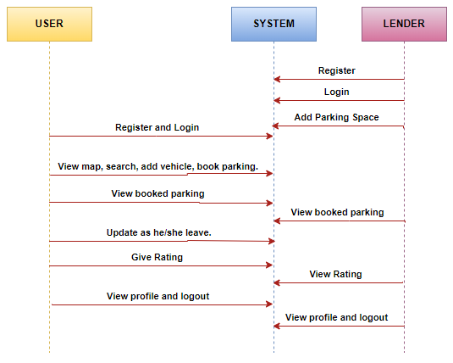
UML Diagrams
Sequence Diagram:
A sequence diagram in Unified Modelling Language (UML) is a kind of interaction diagram that shows how processes operate with one another and in what order. It is a construct of a Message Sequence Chart. Sequence diagrams are sometimes called event diagrams, event scenarios, and timing diagrams.

Slide 20
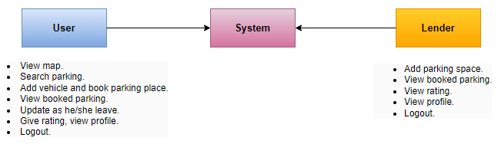
UML Diagrams
Collaboration Diagram:
In collaboration diagram the method call sequence is indicated by some numbering technique as shown below. The number indicates how the methods are called one after another. We have taken the same order management system to describe the collaboration diagram. The method calls are similar to that of a sequence diagram. But the difference is that the sequence diagram does not describe the object organization whereas the collaboration diagram shows the object organization.

Slide 21
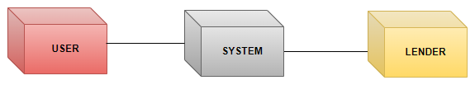
UML Diagrams
Deployment Diagram:
Deployment diagram represents the deployment view of a system. It is related to the component diagram. Because the components are deployed using the deployment diagrams. A deployment diagram consists of nodes. Nodes are nothing but physical hardware’s used to deploy the application.

Slide 22
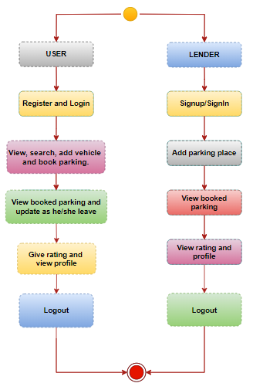
UML Diagrams
Activity Diagram:
Activity diagrams are graphical representations of workflows of stepwise activities and actions with support for choice, iteration and concurrency. In the Unified Modelling Language, activity diagrams can be used to describe the business and operational step-by-step workflows of components in a system. An activity diagram shows the overall flow of control.

Slide 23
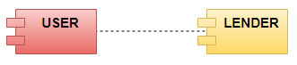
UML Diagrams
Component Diagram:
A component diagram, also known as a UML component diagram, describes the organization and wiring of the physical components in a system. Component diagrams are often drawn to help model implementation details and double-check that every aspect of the system's required functions is covered by planned development.

Slide 24
UML Diagrams
ER Diagram:
An Entity–relationship model (ER model) describes the structure of a database with the help of a diagram, which is known as Entity Relationship Diagram (ER Diagram). An ER model is a design or blueprint of a database that can later be implemented as a database. The main components of E-R model are: entity set and relationship set.
An ER diagram shows the relationship among entity sets. An entity set is a group of similar entities and these entities can have attributes. In terms of DBMS, an entity is a table or attribute of a table in database, so by showing relationship among tables and their attributes, ER diagram shows the complete logical structure of a database. Let’s have a look at a simple ER diagram to understand this concept.

Slide 25
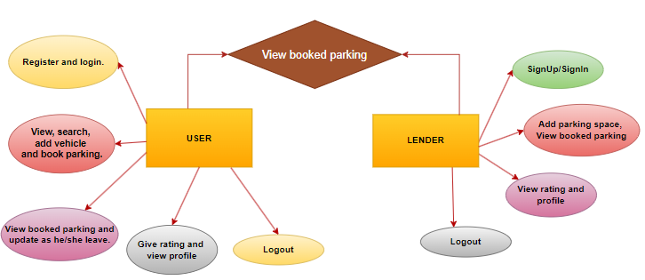
UML Diagrams

Slide 26
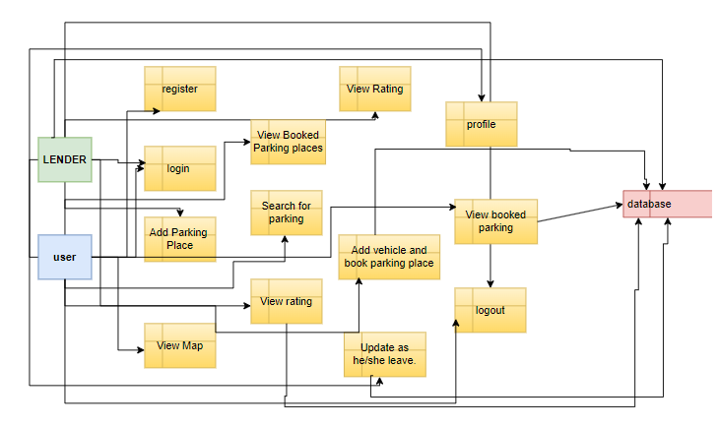
DFD Diagrams

Slide 27
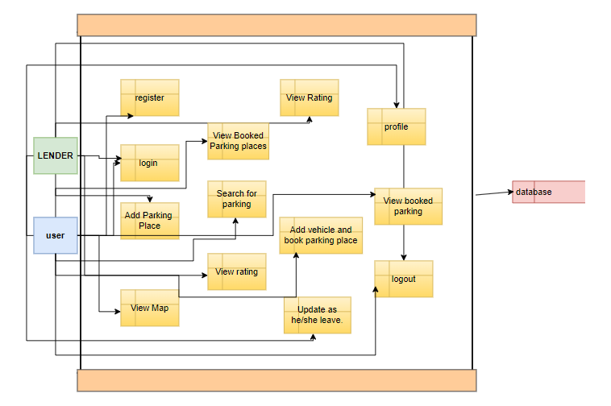
DFD Diagrams

Slide 28
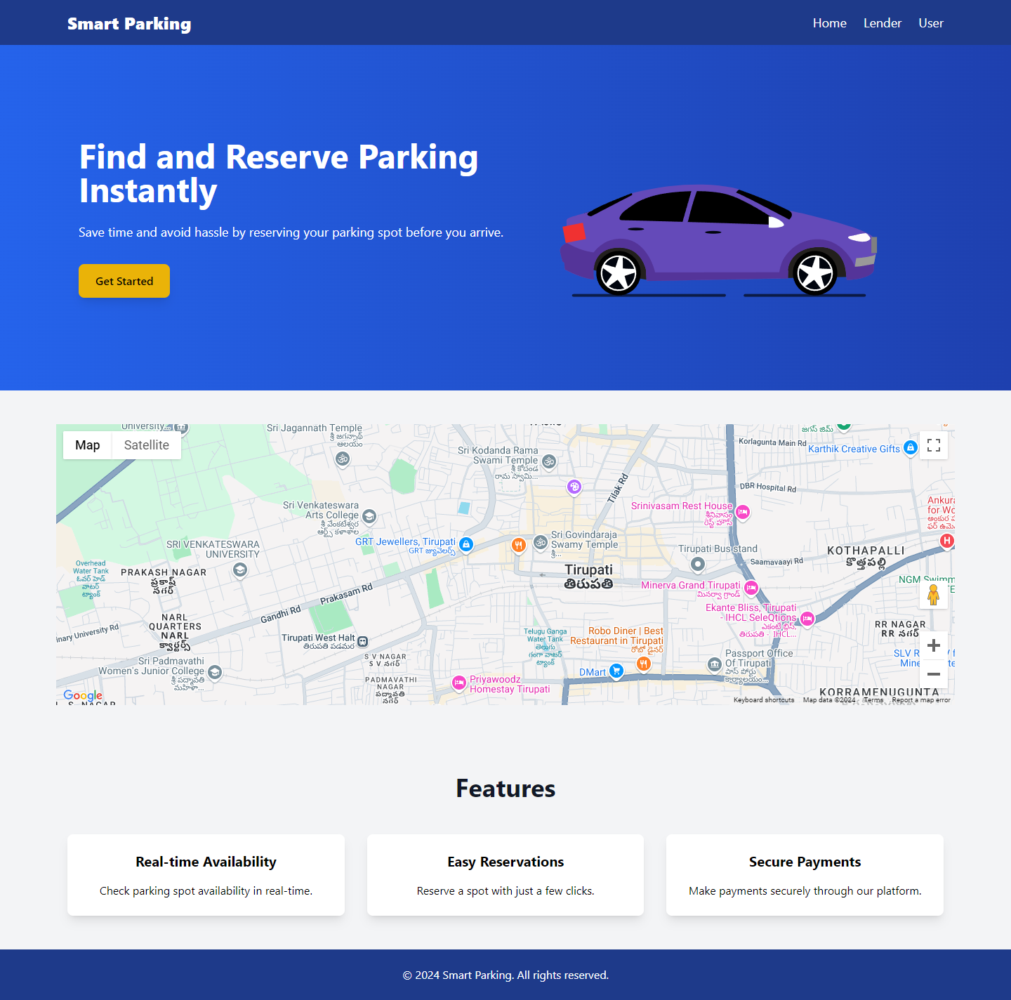
OUTPUT SCREENS
Homepage: default-landing page here about the project and services components are there

Slide 29
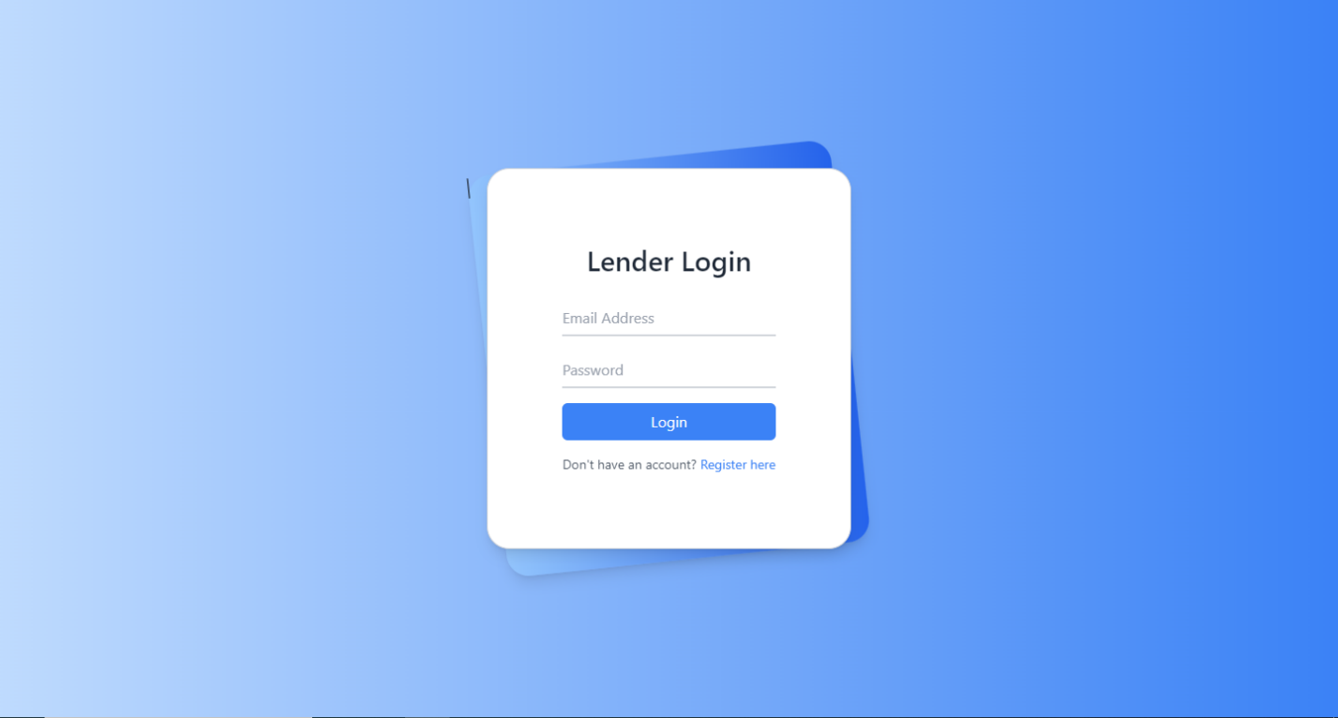
OUTPUT SCREENS
Lender Login: Lender will login to the application by entering credentials

Slide 30
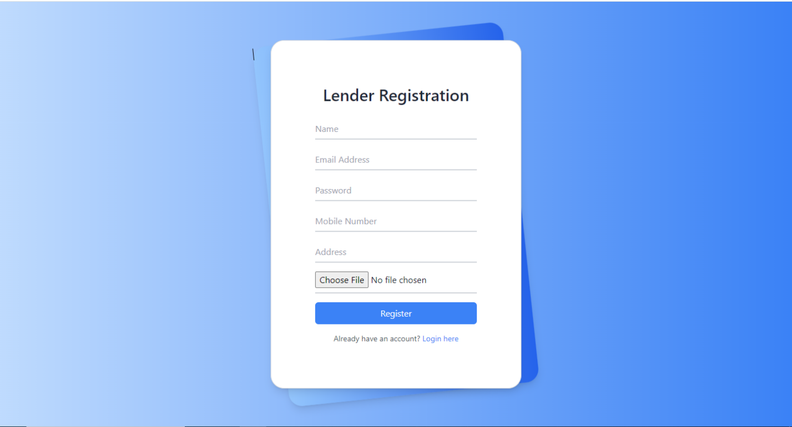
OUTPUT SCREENS
Lender Register: Lender will register into application by entering his details

Slide 31
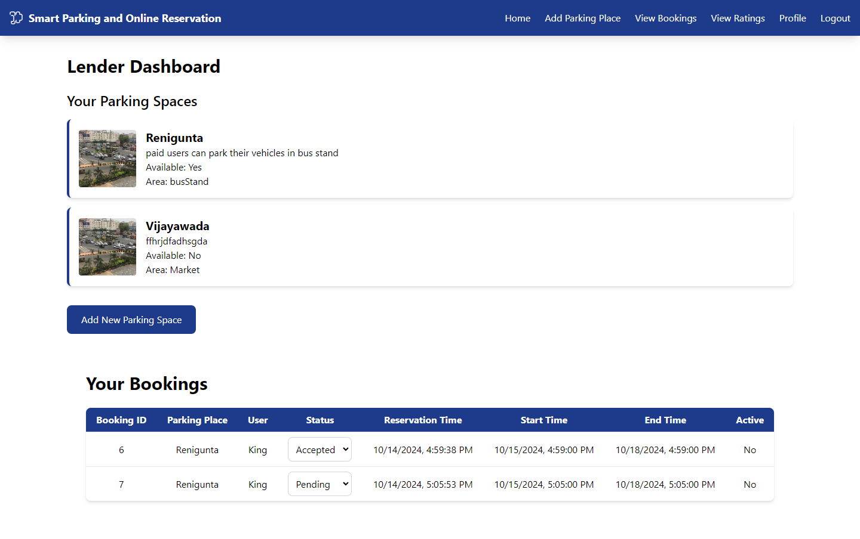
OUTPUT SCREENS
Lender Home: After successful login, lender will redirect to his homepage

Slide 32
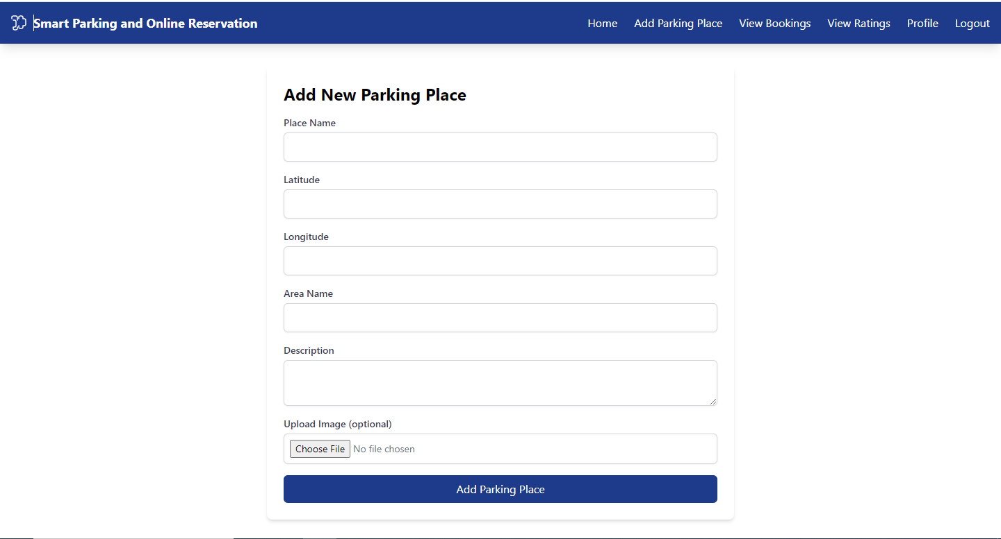
OUTPUT SCREENS
Add Parking Place: Lender will add the parking places

Slide 33
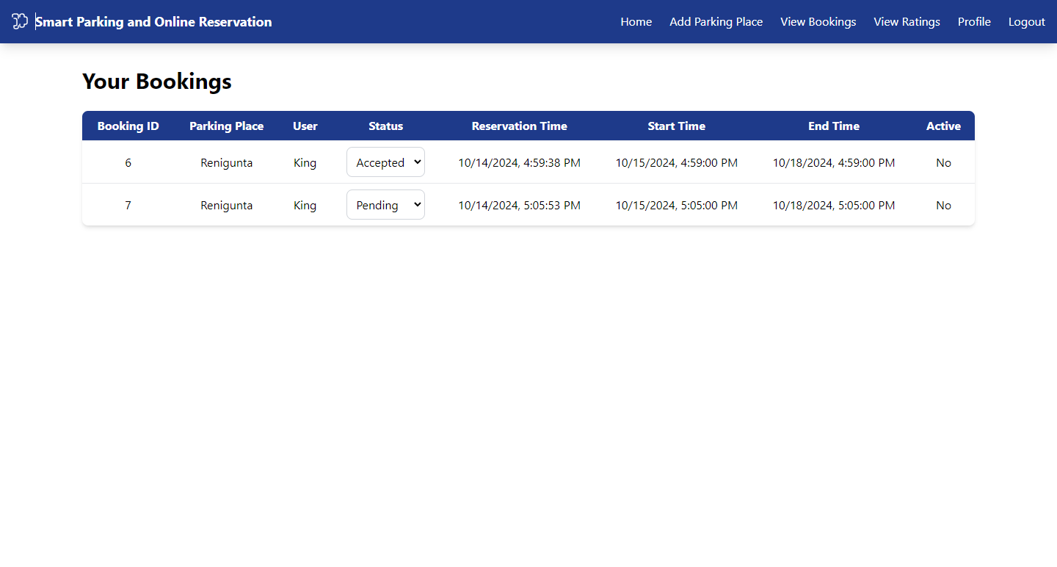
OUTPUT SCREENS
View Bookings: lender will view his bookings.

Slide 34
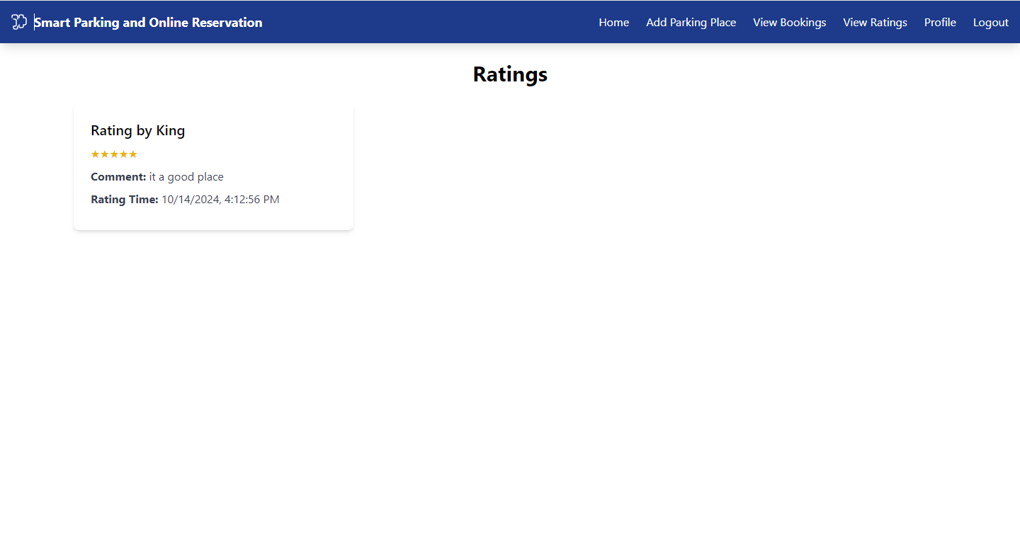
OUTPUT SCREENS
View Ratings: Lender will view his ratings

Slide 35
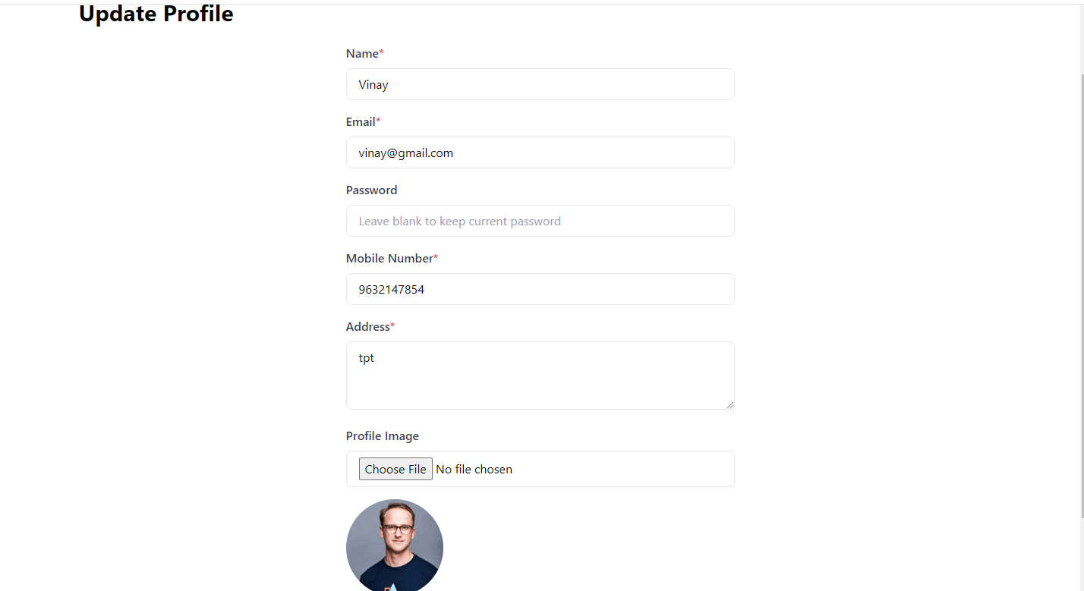
OUTPUT SCREENS
Update Profile: Lender can update his profile.

Slide 36
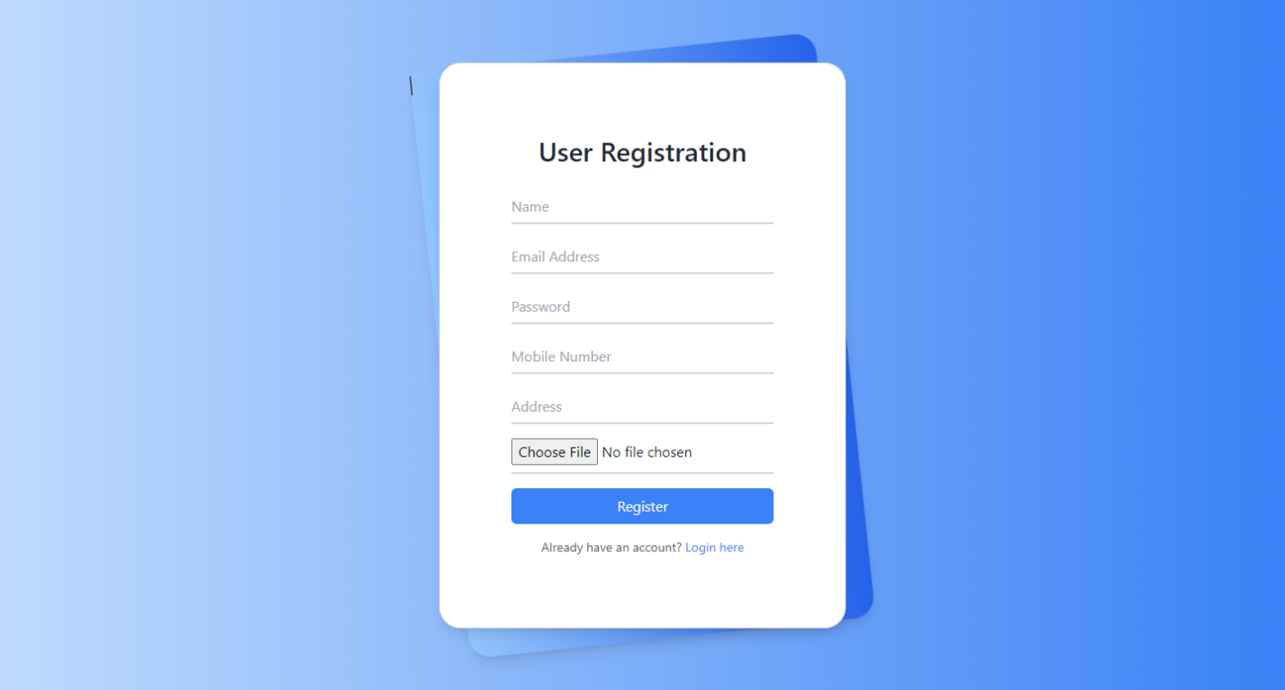
OUTPUT SCREENS
User Register:

Slide 37
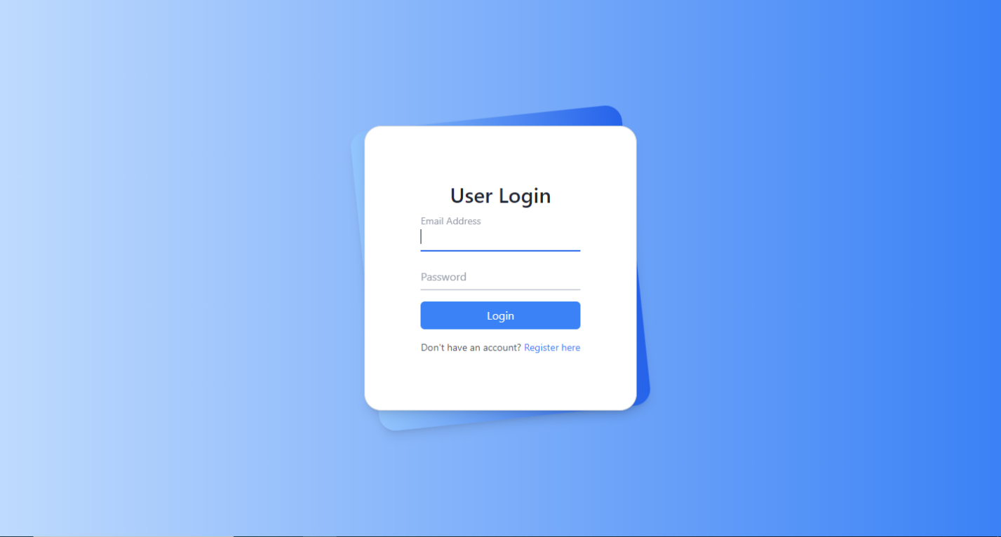
OUTPUT SCREENS
User Login:

Slide 38
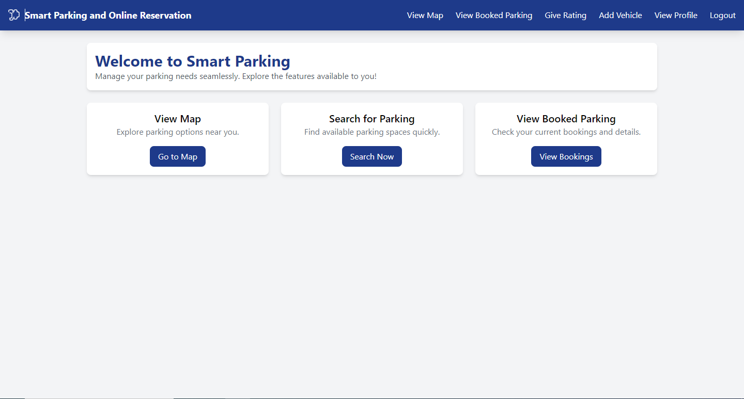
OUTPUT SCREENS
User Home:

Slide 39
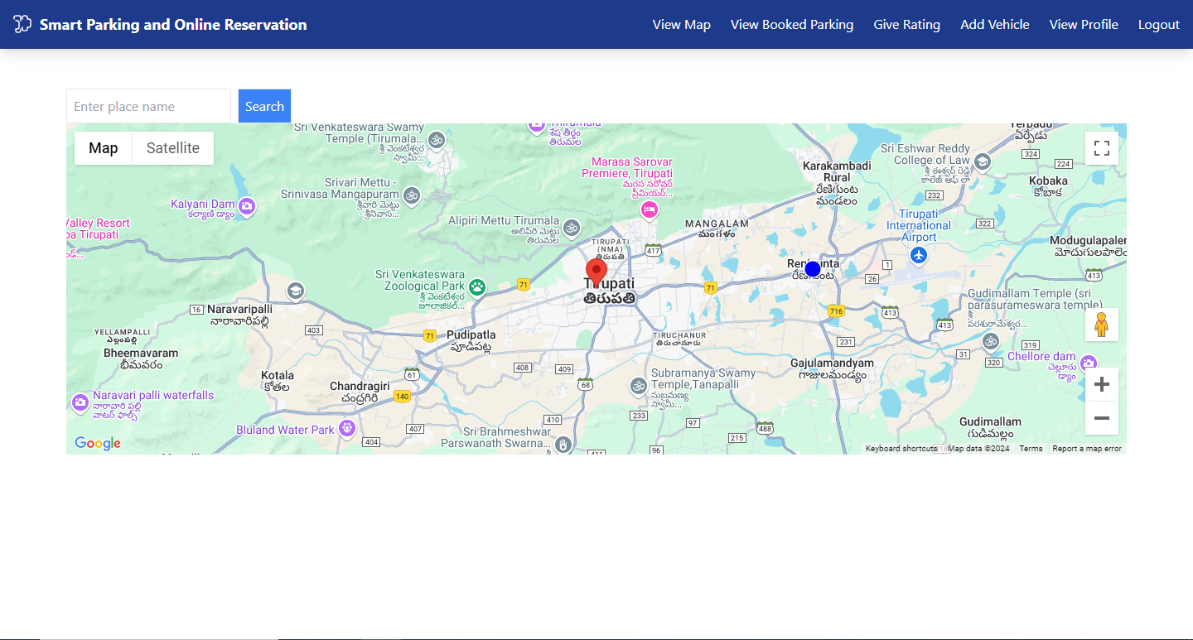
OUTPUT SCREENS
View Map:

Slide 40
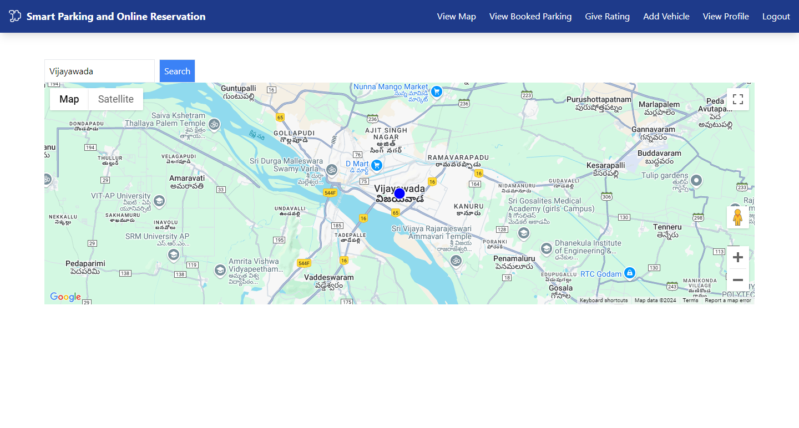
OUTPUT SCREENS
Search Parking Place

Slide 41
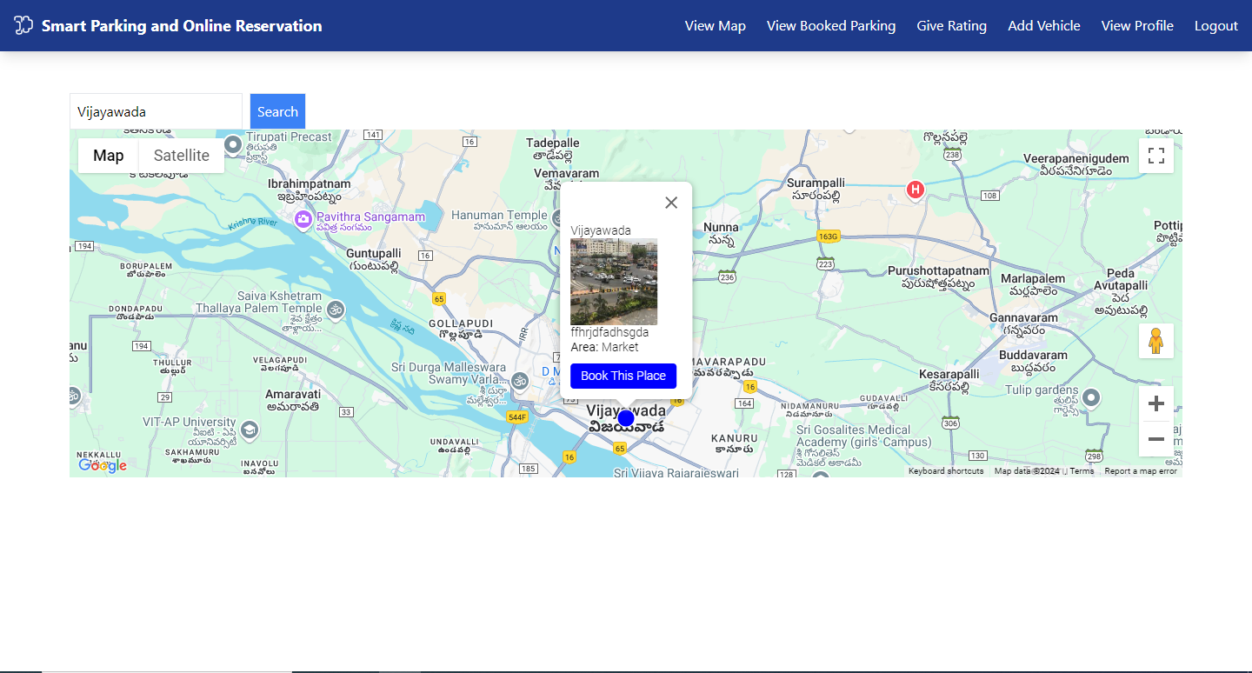
OUTPUT SCREENS
User View Parking Place:

Slide 42
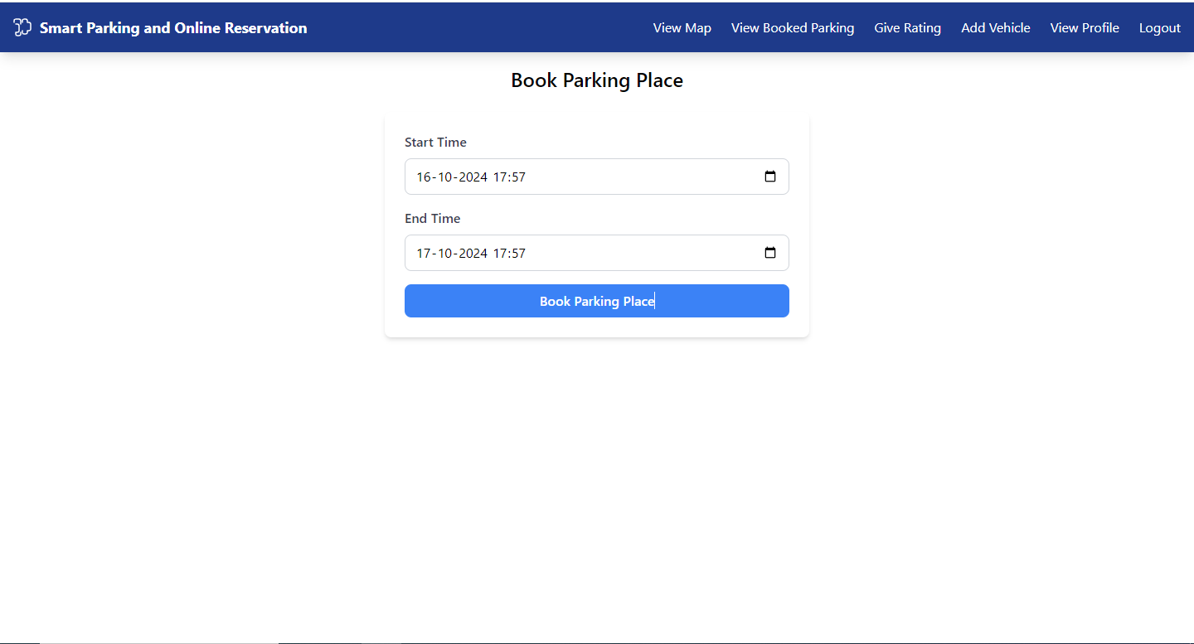
OUTPUT SCREENS
Book His Parking Place:

Slide 43
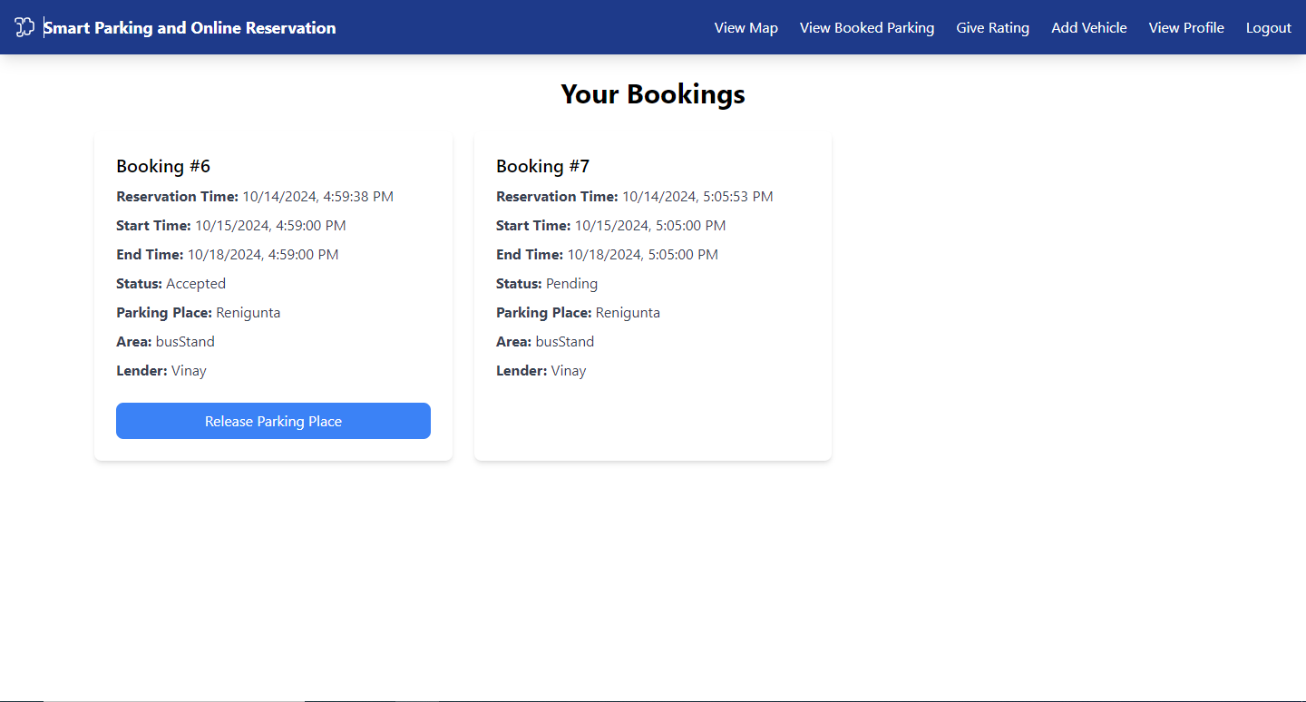
OUTPUT SCREENS
View His Booking and Status:

Slide 44
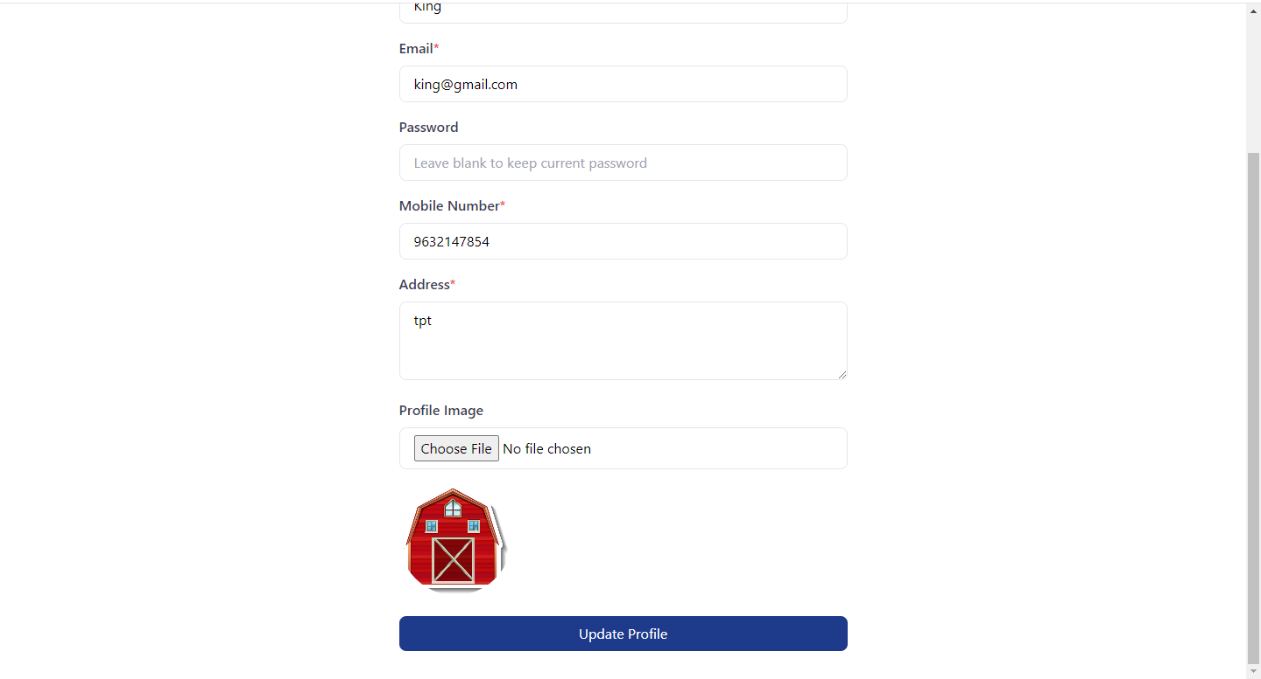
OUTPUT SCREENS
Update Profile:

Slide 45
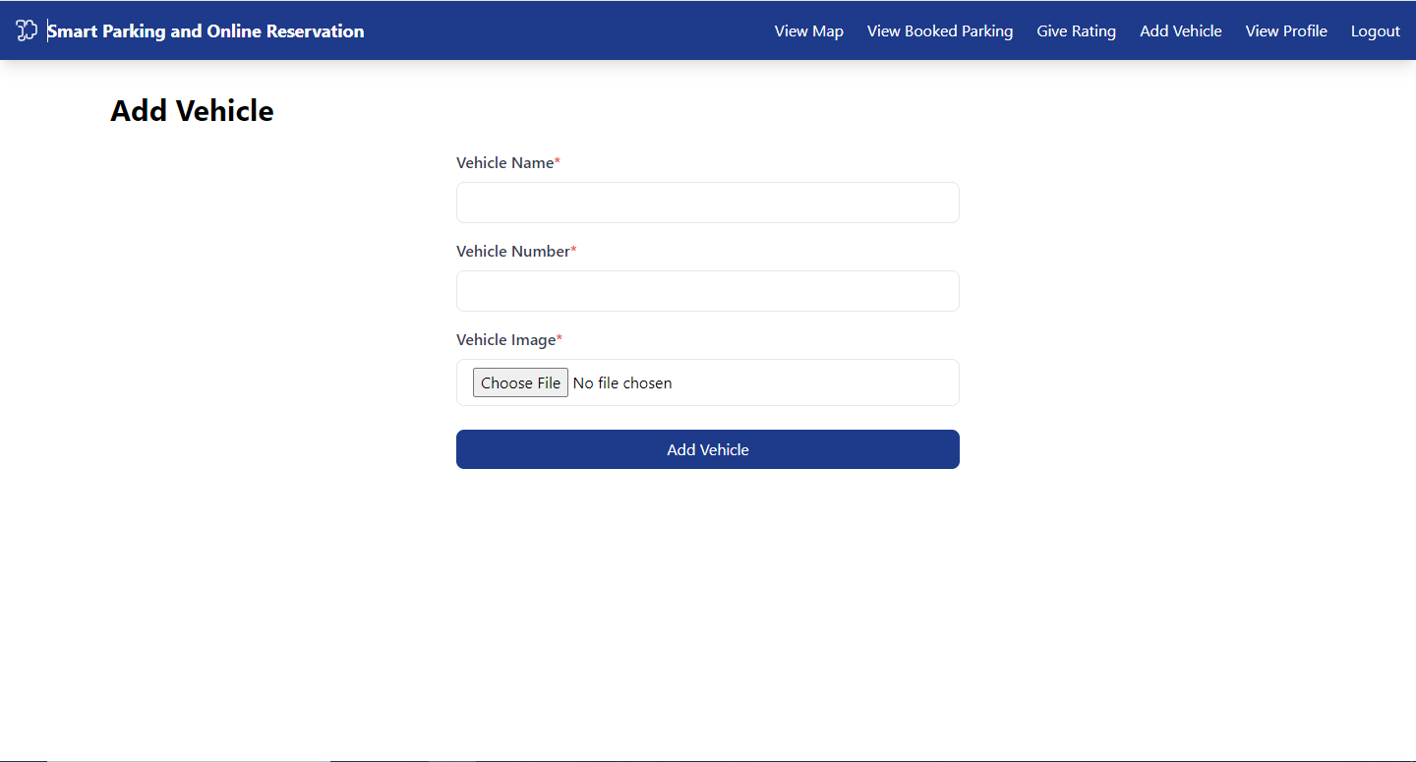
OUTPUT SCREENS
Add Vehicles:

Slide 46
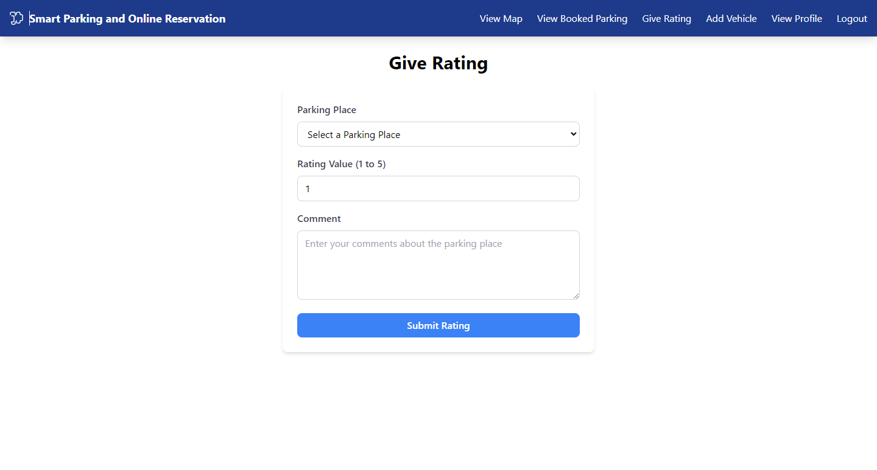
OUTPUT SCREENS
Give Rating:

Slide 47
FUTURE ENHANCEMENT
Real-time parking spot availability alerts: Implement push notifications or SMS alerts when parking spots in users' preferred locations become available. Geolocation-based notifications can further enhance convenience by notifying users based on proximity.
Integration with digital payment wallets: Integrate popular digital payment wallets like PayPal, Google Pay, and Apple Pay to offer secure and convenient payment options. This will streamline the booking process, especially with one-tap payments for returning users.
Dynamic pricing based on demand: Implement dynamic pricing that adjusts fees based on time, location, and demand. Peak hours and high-demand areas can have higher prices, while off-peak hours offer discounts, promoting efficient space usage.
User loyalty and rewards program: Introduce a loyalty program that rewards users with points for frequent bookings and positive feedback. Points can be redeemed for discounts, and lenders can receive incentives for maintaining high service standards.

Slide 48
CONCLUSION
In conclusion, the Smart Online Parking and Reservation System offers a comprehensive solution to modern parking challenges by bridging the gap between parking seekers and space lenders. With its intuitive interface, real-time parking management, and secure booking features, the system provides a seamless experience for users while enabling lenders to optimize the use of their vacant spaces. The integration of Spring Boot, React, and a MySQL database ensures a reliable and scalable platform capable of managing the growing demands of urban parking. By improving accessibility, transparency, and resource efficiency, this system promotes smarter urban mobility, contributing to more sustainable city living.

Slide 49
REFERENCES
Smith, J., & Williams, L. (2021). "Smart Parking Systems for Urban Environments: A Comprehensive Review." Journal of Traffic and Transportation Engineering, 8(3), 45-60.
Kumar, R., & Singh, P. (2020). "Design and Development of an IoT-based Smart Parking System." International Journal of Innovative Technology and Exploring Engineering (IJITEE), 9(5), 21-30.
Patel, M., & Shah, A. (2019). "Efficient Parking Management System Using Web and Mobile Technologies." International Journal of Computer Applications, 175(6), 12-18.
Zhang, Y., & Lee, C. (2018). "A Cloud-based Smart Parking System for Urban Areas." IEEE Access, 6(12), 10294-10305.
Rahman, A., & Rahim, M. (2021). "Automated Smart Parking Reservation System Using Machine Learning Algorithms." International Journal of Computer Science and Information Security (IJCSIS), 19(1), 33-40.

Slide 50
REFERENCES
Gupta, S., & Desai, H. (2020). "Urban Parking Solutions: Integrating IoT and Smart Technology." Journal of Urban Mobility Systems, 5(2), 57-65.
Chen, W., & Zhang, L. (2019). "Smart City Parking: A Case Study on Parking Reservation Systems." Journal of Smart Cities Research, 3(4), 98-107.
Martinez, F., & Gonzalez, A. (2020). "Development of a Real-Time Parking Space Management System." International Journal of Science and Research (IJSR), 9(11), 120-130.
Singh, A., & Kaur, R. (2021). "Smart Parking Reservation with Predictive Analytics." International Journal of Engineering Science and Computing, 11(3), 22-30.
Lee, S., & Choi, K. (2020). "Optimizing Parking Space Allocation in Smart Parking Systems.” International Journal of Electrical and Computer Engineering (IJECE), 10(5), 67-74.

